Slide 1
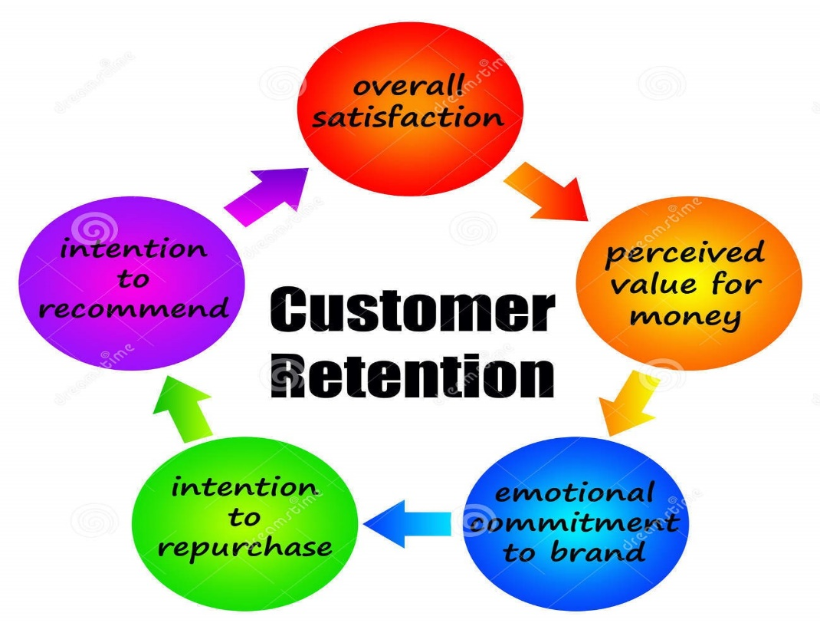
Customer Retention Case Study Presentation
by
ARPAN PATTANAYAK

Slide 2

Agenda:
Introduction
Problem Statement
Objective
Exploratory Data Analysis (EDA)
Visualization
Inference
Conclusion

Slide 3
Introduction
Customer retention refers to company’s ability to turn customers into repeat buyers and prevent them from switching to a competitor
In other words, customer retention means – “To maintain the existing customers”
This happens only if there exists a positive relation between the company and the customer.
Nowadays, online shopping is a fast-growing phenomenon. Growing numbers of consumers shop online to purchase goods and services, gather product information or even browse for enjoyment. Online shopping environments are therefore playing an increasing role in the overall relationship between marketers and their consumers.

Slide 4
What are the benefits of Customer Retention ?
Retained customers tend to buy other services from same company.
Retained customers are known to be less price/cost sensitive
The probability of selling to an existing customer is 60-70%
The probability of selling to new prospect is 5-20%
Declined migration rates
It’s more expensive to acquire a new customer than to retain an old one.

Slide 5
Tips for Succeeding at Customer Retention
Find out what customers want & what causes them to stay or leave ?
Proactively collect and promote customer feedback.
Analyze customer feedback to gain valuable insights and ensure the right people hear it.
Take action and Measure the results
Actively measure and monitor your customers’ loyalty and engagement
Keep asking, listening analyzing and improving

Slide 6
Motivation for the Problem Undertaken
Successful customer retention involves more than giving the customer what they expect.
Generating loyal advocates of the brand might mean exceeding customer expectations.
Creating customer loyalty puts 'customer value rather than maximizing profits and shareholder value at the center of business strategy’.
The key differentiation in a competitive environment is often the delivery of a consistently high standard of customer service.
Furthermore in the emerging world of Customer Success, retention is a major objective.

Slide 7
Problem Statement
Customer satisfaction has emerged as one of the most important factors that guarantee the success of online store; it has been posited as a key stimulant of purchase or repurchase intentions and customer loyalty.
A comprehensive review of the literature, theories and models have been carried out to propose the models for customer activation and customer retention.
Five major factors that contributed to the success of an e-commerce store have been identified as: service quality, system quality, information quality, trust and net benefit.
The research furthermore investigated the factors that influence the online customers repeat purchase intention.
The combination of both utilitarian value and hedonistic values are needed to affect the repeat purchase intention (loyalty) positively.
The data is collected from the Indian online shoppers. Results indicate the e-retail success factors, which are very much critical for customer satisfaction.

Slide 8
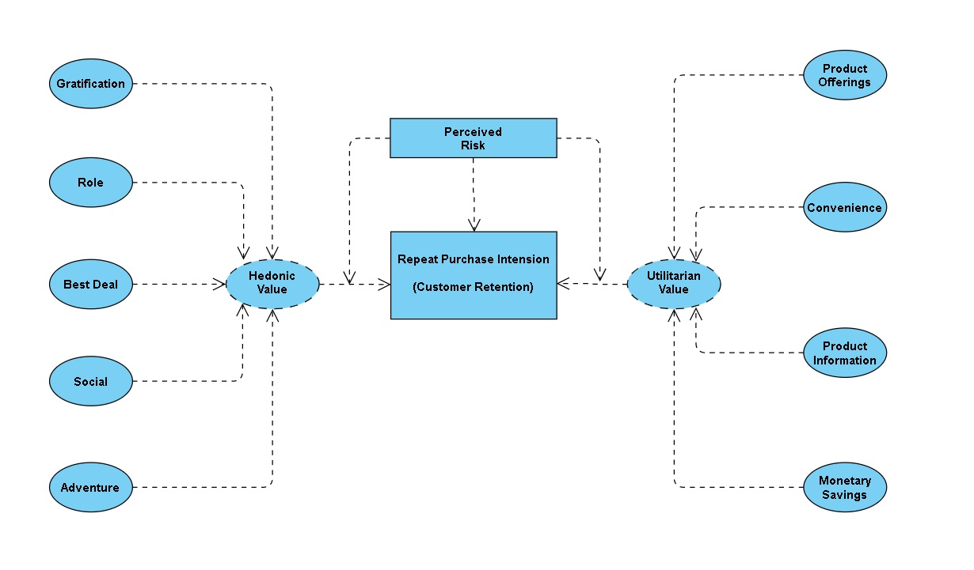
The problem statement can be represented in the form of below use case diagram as well.

Slide 9
Objective
The objective is to apply the analytical skills to provide findings and conclusion that would help to predict customer retention for a E-Retail company using their data on users provided over period of time.
Using the model I was tasked with determining which features were most influential in loss of valuable customer and then making a plan for how the company could use this information to increase customer retention.

Slide 10
Data Analysis Steps Done :
Import Libraries
Import Dataset
Data Preprocessing
Label Encoding & Checked for Correlation
Visualization
(EDA)
Finding null values

Slide 11
Shape : 269 rows and 71 columns.
No null values present.
22% duplicate fields/records found.
Datatypes of all the columns are objects except for the “Pin Code" column which has integers.
First I have imported the necessary libraries and loaded the entire dataset in our Jupyter Notebook and renamed the columns.
Then I checked the shape of our dataset and found that we have a total of 269 rows and 71 different columns.
We don’t have any null values or missing values present in our dataset.
There is 22% percent of duplicate records in our dataset however I have chosen to retain those information instead of removing them.
By checking the data types I came to know that all the columns have ‘object’ data type except the column representing the Pin Code which has ‘integer’ data type.

Slide 12





Dataset Description
The data is collected from the Indian online shoppers. Our Dataset consists of reviews and feedbacks of customers on 5 top Indian Online Retailers : Amazon, Flipkart, Snapdeal, Myntra and Paytm.
Questionnaire is formed on the basis of brand strength, brand empathy or commitment, overall customer satisfaction and perceived value for money with intention to recommend.
Results indicate the e-retail success factors which are very much critical for customer satisfaction and retention.
The top 5 Indian Online Retailers:

Slide 13
Exploratory Data Analysis (EDA):
While looking into the value count function I found some duplicate entries in the columns, so I have replaced them.
Checked the null values and found no null values in the dataset.
Performed both univariate and bivariate analysis and visualized each feature using seaborn and matplotlib libraries by plotting count plot, distribution plot and box plot.

Slide 14
Visualization
What is Data Visualization? Data visualization is defined as a graphical representation that contains the information and the data.
Benefits of Good Data Visualization? Data visualization is another technique of visual art that grabs our interest and keeps our main focus on the message captured with the help of eyes.
Different Types of Analysis for Data Visualization are Univariate Analysis: In the univariate analysis, we will be using a single feature to analyze almost all of its properties. Bivariate Analysis: When we compare the data between exactly 2 features then it is known as bivariate analysis. Multivariate Analysis: In the multivariate analysis, we will be comparing more than 2 variables.

Slide 15
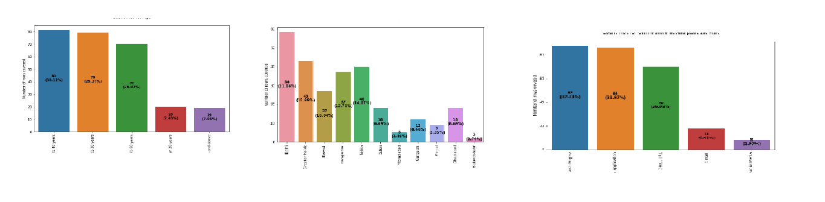
Univariate Analysis:
With the help of count plots, I was able to get the total number of rows covered by each unique categorical value present in all the columns of our dataset.
I ensured that along with the total row number the percentage of data coverage is made visible too.

Slide 16
Observation from Graph
Female buyers are more in number than male in the Dataset.
Buyer Age between 31 to 40 years is more followed by 21-30 years for online shopping.
Delhi city has a maximum number of buyers followed by greater Noida & Noida. Bulandshahr city has a minimum number of buyers for online shopping.
Tenure wise maximum buyers are preferred online shopping since 4+ years.
Maximum number of online buyers purchased less than 10 products in past one year.
Using mobile phone internet is more for online shopping.
Smart Phone has been used more for online shopping followed by laptop.
Smartphones having screen sizes other than 4.7, 5.5 & 5 inches had been used more times for online shopping.
Devices having a windows operating system has been used often more for online shopping followed by android.
Google Chrome browser is used maximum times to access the website as compared to other browsers.
Search engine is more useful for the potential online buyers, also after the 1st visit to the store, the search engine has been used more to locate the website.
Usually buyers explore the particular website more than 15 times before making a purchase decision.
Credit/Debit has been used more than other options for online purchases.

Slide 17
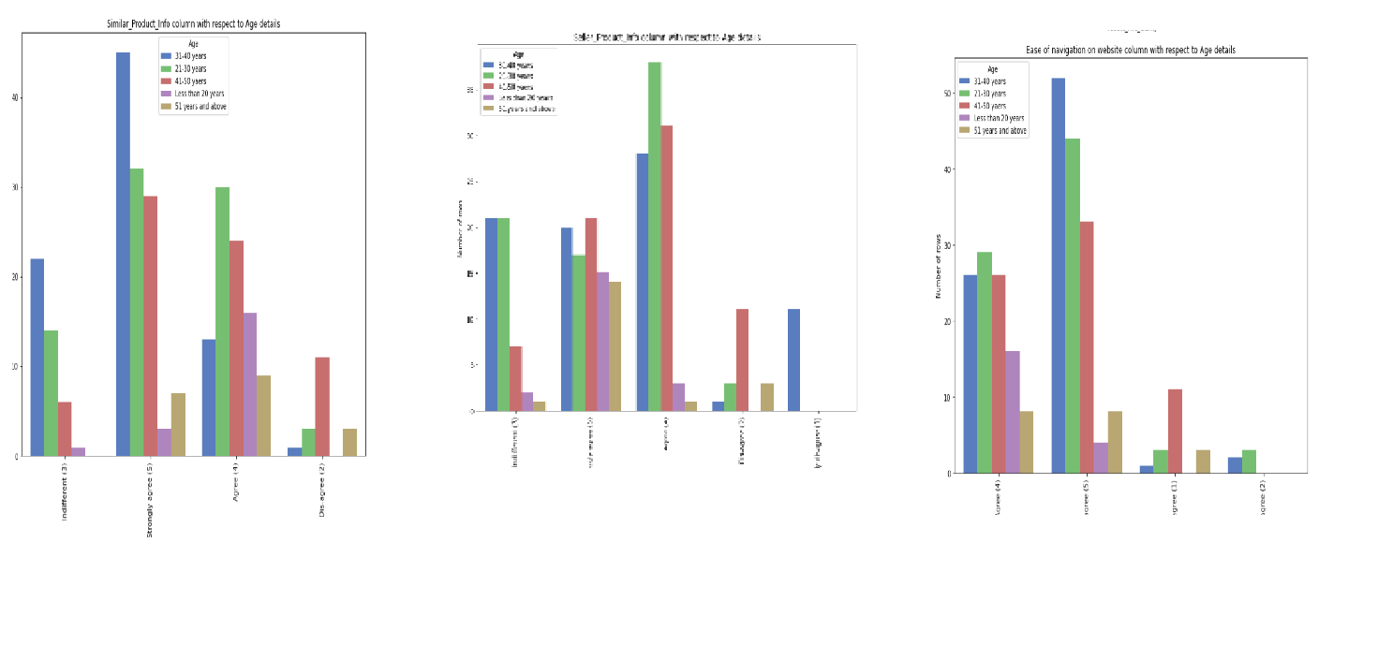
Bivariate Analysis:
Using the count plot along with the hue parameter I was able to generate analysis details comparing 2 columns of the dataset where the hue remained constant while the other one kept changing inside a loop.
The hue used n this plot is the “Gender” column showing the legend accordingly.

Slide 18
Observation from Graph
More Female are from Greater Noida followed by Bangalore. Where as most men shoppers are from Delhi.
Amongst the respondents, the major class targeted is between 21-40 years, followed by 41-50 and less than 20 years.
The respondents are majorly residing in cities like Delhi, Greater Noida, Noida and Bangalore.
Majority are shopping online for more than 4 years. There are considerable people who are shopping online since less than one year and it shows that many new customers are being added every year.
We can observe that many have shopped less than 10 times in the past year.
Many of them use mobile to shop online, followed by laptop, desktop, and tablet.
Windows constitute the major OS of the customer device, followed by Android and Mac.
Google Chrome is majorly used to access the shopping website.
People are becoming customers of their favorite stores by using the search engine. Content marketing or display advertisements are not that impactful when coming to online marketing. So companies should spend more on advertising on search engines.
For repeated visits, people use search engine first, followed by app and direct URL. We can see that difference between app and search engine is small.
Majority of the people spend more than 15 minutes before making a purchase, followed by 6-10 minutes.
The major payment method used by all is credit/debit cards, followed by COD and e-wallets.

Slide 19
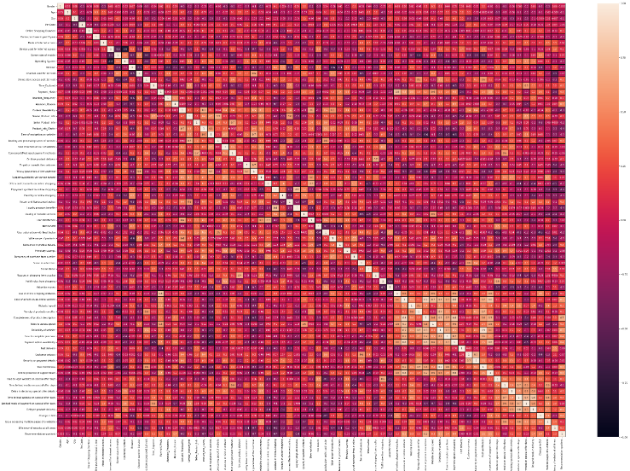
Multivariate Analysis:
I used the heatmap on the encoded dataset to see the correlation details between the columns.
Even on the Jupyter Notebook the picture was too tiny however seeing the color combinations I was able to figure out that there is no multi collinearity concern between the columns.

Slide 20
Inference
Based on overall observations the first 47 features provide insights on how e-retail is helpful and growing based on customer inputs. The data explained how the online platform has been used more often in which CITY, PIN CODE, AGE etc. It also showed us that in some factors there is less importance given to contribute to the success of an e-commerce store, so based on that we could remove those factors and keep all the important factors. Also we could improve on some factors that influence the online customers repeat purchase intention.
Apart from the first 47 features the rest of the features showed which online platform has been used more based on the success factors. Based on the case study for customer activation and retention, Amazon is the most reliable and has been fulfilled all the customer requirements. After Amazon the data showed Flipkart has been used more for online shopping.
The case study from Indian e-commerce customers showed Amazon and Flipkart has been used mostly for Online Shopping and most recommended by Friends. So based on the research factors Amazon and Flipkart are the e-commerce platform which are having the combination of both utilitarian and hedonistic values to keep the repeat purchase intention (loyalty) positively.

Slide 21

1. Amazon.com
To be improved:
1. During promotions, try to give a disturbance free shopping experience to customers.
2. Give more payment options to customers.
3. Try to give price early during promotion.
4. Reduce the delivery time of the products.
Positive feedback summary:
1. Convenient to use and also a good website for shopping.
2. Fast delivery of products.
3. Availability of complete information of the products.
4. Presence of online assistance through multi-channels.
5. Reliable website or app, perceived trustworthiness.
Online Store Company:

Slide 22

2. Flipkart.com
To be improved:
1. During promotions, try to give a disturbance free shopping experience to customers.
2. Give more payment options to customers.
3. Try to give the price early during promotion.
4. Reduce the delivery time of the products.
5. Flipkart and Amazon almost share the same feedbacks with varying percentages as the only difference.
Positive feedback summary:
1. Convenient to use and also a good website for shopping.
2. Fast delivery of products.
3. Availability of complete information of the products.
4. Presence of online assistance through multi-channels.
5. Reliable website or app, perceived trustworthiness.
6. Wild variety of products to offer.
Online Store Company:

Slide 23
3. Myntra.com
To be improved:
1. During promotions, try to give a disturbance free shopping experience to customers.
2. Try to give the price early during promotions.
3. Reduce the delivery time of the products during promotions.
Positive feedback summary:
1. Convenient to use and also a good website.
2. Availability of several payment options.
3. Faster products delivery.
4. Complete information of products available.
5. Reliable website or app, perceived trustworthiness.
6. Wild variety of product to offer
Online Store Company:

Slide 24

4. Paytm.com
To be improved:
1. Reduce the delivery time of the products during promotions.
2. Try to give the price early during promotion.
3. During promotions, try to give a disturbance free shopping experience to customers.
4. Late declaration of price and discounts.
5. Frequent disturbance is occurring while moving from one page to another.
Positive feedback summary:
1. Convenient to use and a good website.
2. Quickness to complete a purchase.
3. About 64% of the customers feel that either web or app is reliable.
4. Around 20% of the customers believe that Paytm has a wild variety of products on offer.
Online Store Company:

Slide 25
5. Snapdeal.com
To be improved:
1. Reduce the delivery time of the products during promotions.
2. Try to give the price early during promotion.
3. During promotions, try to give a disturbance free shopping experience to customers.
4. Late declaration of price and discounts.
5. No one has expressed to recommend Snapdeal to a contact as it has the most negative feedbacks among all other websites.
Positive feedback summary:
1. Convenient to use.
2. 54% of the customers are happy about the availability of financial information security.
Online Store Company:

Slide 26
Conclusion
The dataset is to identify the retention factors of customers in online shopping
In this project, I have renamed the columns to a shorter name, found no null values in columns. Visualized and analyse the data using count plot and encoded the object data into numerical using label encoding method. Checked the statistical summary of the dataset, checked the correlation between features, outliers, and skewness in the dataset.
Based on overall observations, the first few features provide insights into how e-tailer is helpful & growing based on customer inputs. The data explained how the online platform has been used more often Gender wise, City, Age group etc. It also showed that in some factors there is less importance given to contribute to the success of an e-commerce store, so based on that we could remove those factors & keep all the important factors.
Last few features showed which online platform has been used more based on the success factors. Based on the case study for customer activation & retention, Amazon is most reliable and has been fulfilled the customer requirements. After Amazon, data showed Flipkart has been used more for online shopping.
The case study from Indian e-commerce customers showed Amazon and Flipkart has been used mostly for Online Shopping. So, based on the research factors, Amazon & Flipkart are the e-commerce platform, which are having the combination of both utilitarian and hedonistic values to keep the repeat purchase intention (loyalty) positively.

Slide 27


This Photo by Unknown Author is licensed under CC BY-SA

